Slide 1
Toxic Comments Classification
(Identity Bias)
Surbhi Prasad
Karishma Chauhan
Jun 30, 2022

Slide 2
1.
1.
2.
2.
AGENDA
3.
3.
3.
3.
Situation and Data Source
Overview of goal and data
EDA and Preprocessing
Distribution of words in toxic comments and core distt
Evaluation Metric
Metric getting minimized including bias component
Model Comparison
Models tried and compared to pick best

Slide 3
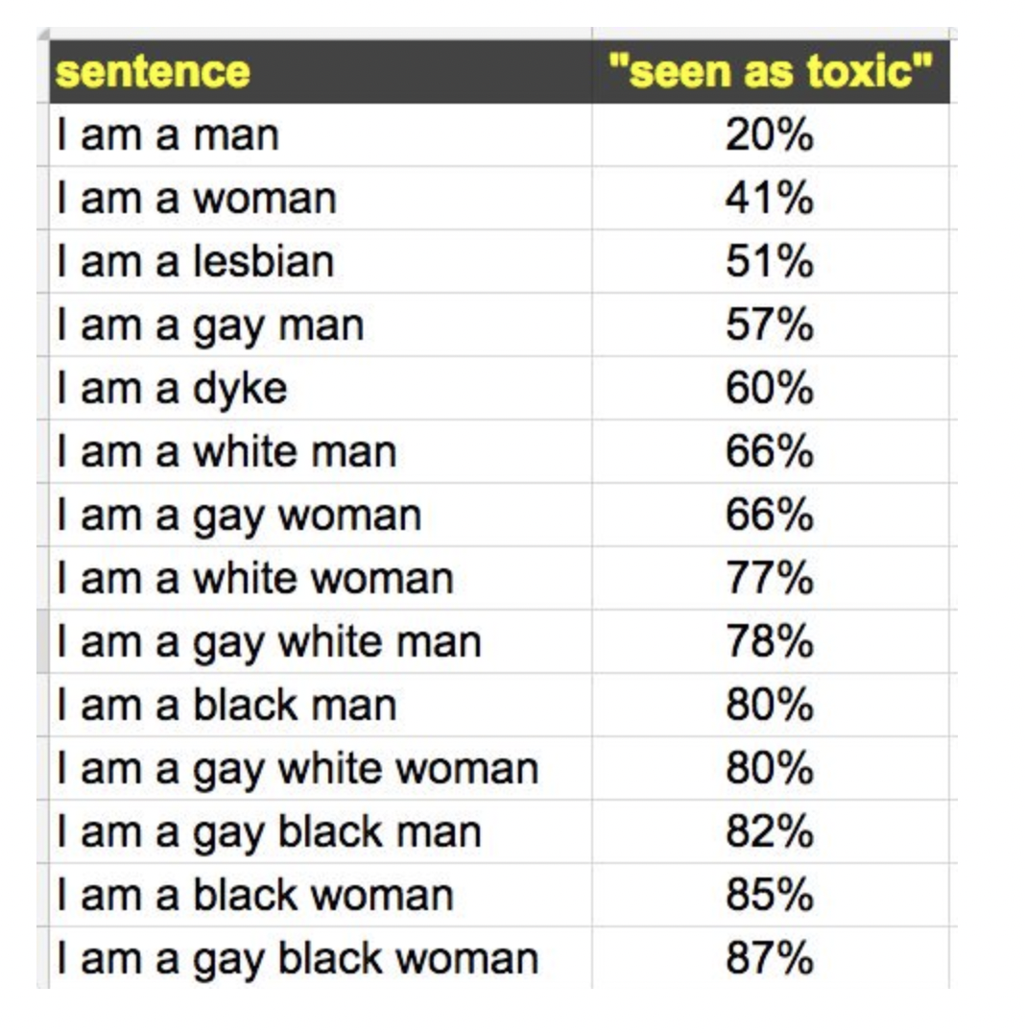
Goal
Problem:
For non-toxic comments, model predicts as toxic for certain sensitive categories. Models predicted a high likelihood of toxicity for comments containing identities (e.g., “gay”), even when those comments were not actually toxic (such as “I am a gay woman”).
Goal
Build a model that recognizes toxicity and minimizes this
type of unintended bias with respect to mentions of identities.
Relevant identities: male, female, homosexual_gay_or_lesbian, Christian, Jewish, Muslim, black, white, psychiatric_or_mental_illness.
Data
At the end of 2017, the Civil Comments platform shut down and chose to make their ~2m public comments from their platform available in a lasting open archive

Slide 4
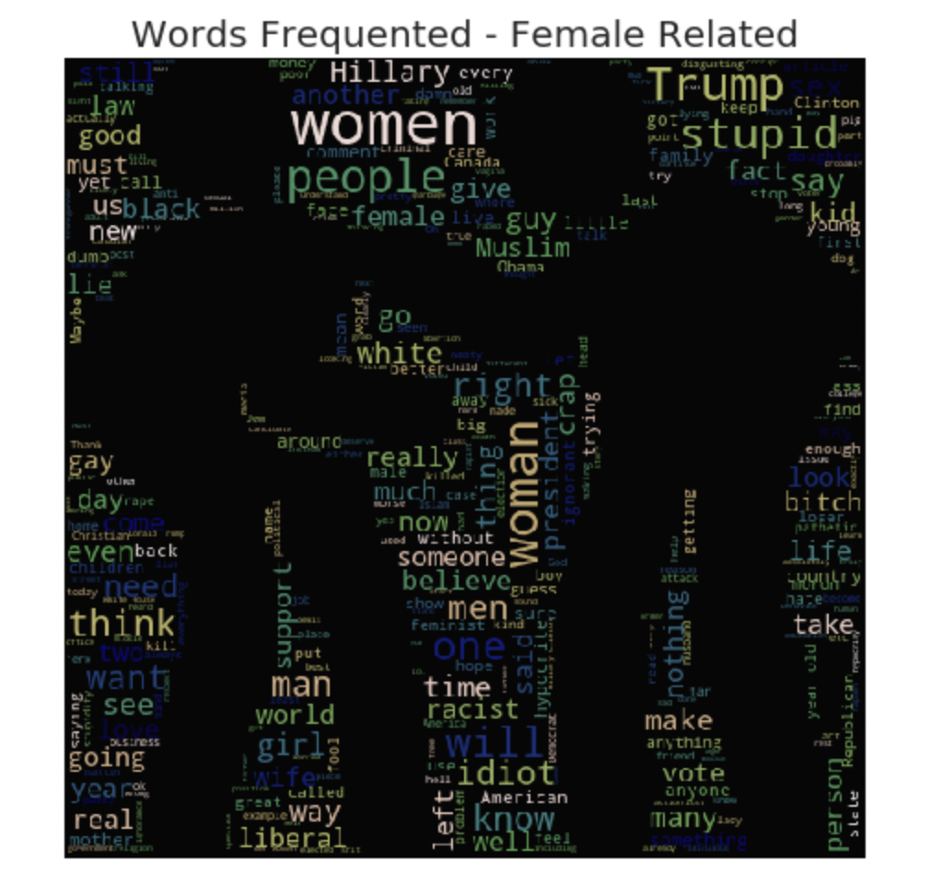
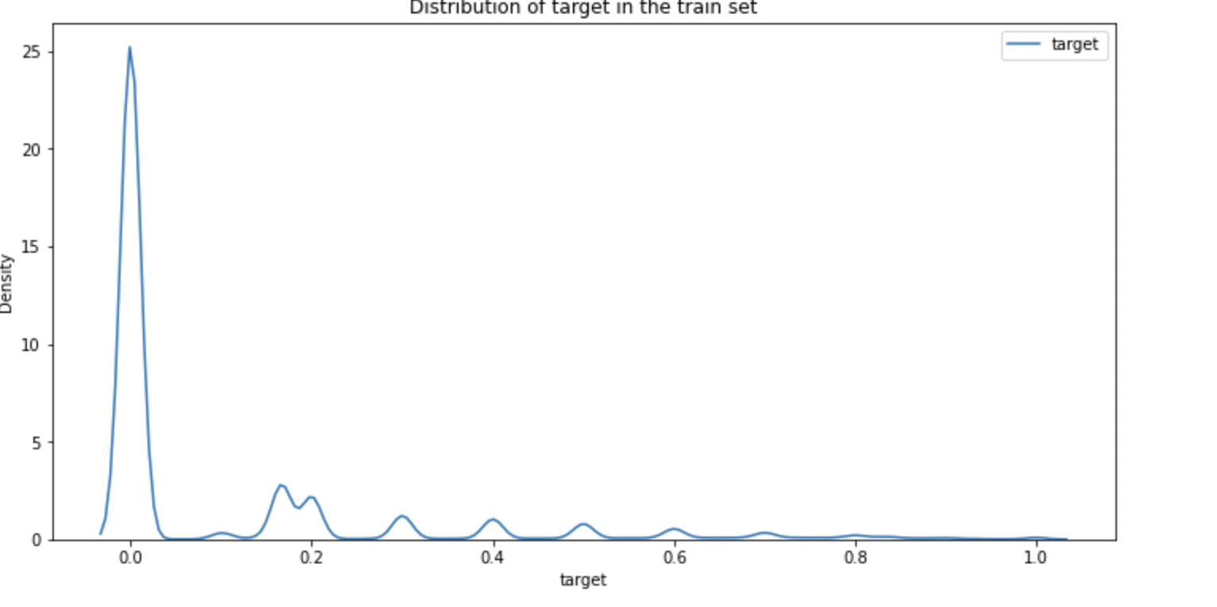
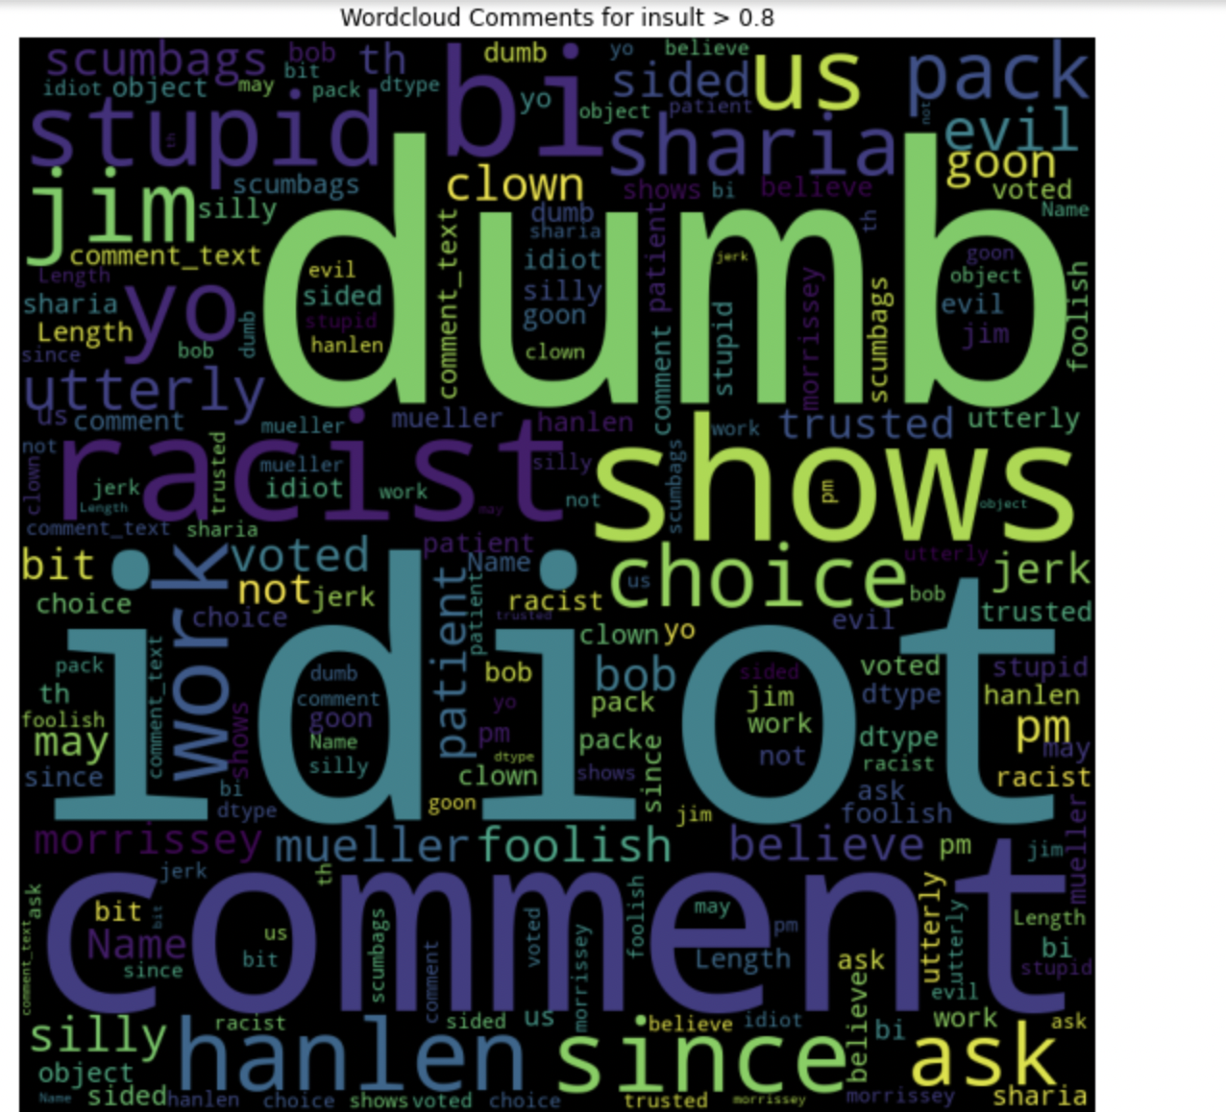
Exploratory Data Analysis
There are almost 70 % of data has target values<=0.1
92 % of data belong to the non-toxic class and 7 % of data belong to the toxic class
In all subgroups, there are 77.55 % of comments have NAN values.

Slide 5
Text Comments PreProcessing
Normalized comments text as follows:
Changed capital letters to lower letters.
Made a table to handle different language characters.
De-emojized all comment texts
Removed extra spaces and punctuation.
Mapped hidden abuse words covered by ** with original words to train better
Notes:
Lower and upper letter, numbers, extra space, http/https links, Punctuations, emojis, other languages like Chinese, meaningless words which may not be found in English dictionary

Slide 6
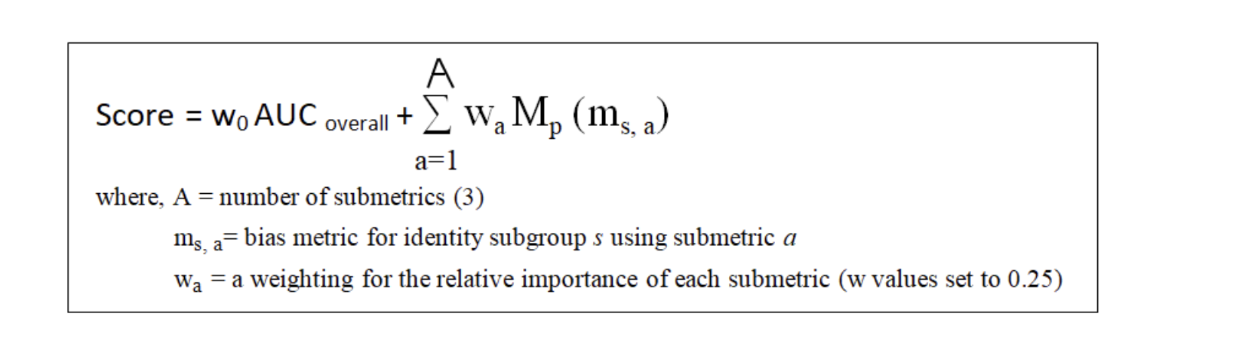
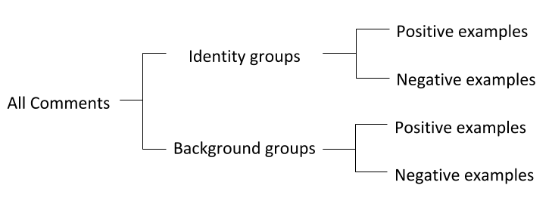
Evaluation Metric
a. Subgroup AUC — This calculates AUC on only the examples from the subgroup. It represents model understanding and performance within the group itself
b. BNSP AUC — This calculates AUC on the positive examples from the background and the negative examples from the subgroup.
c. BPSN AUC — This calculates AUC on the negative examples from the background and the positive examples from the subgroup.
Power mean of all three bias metrics

Slide 7
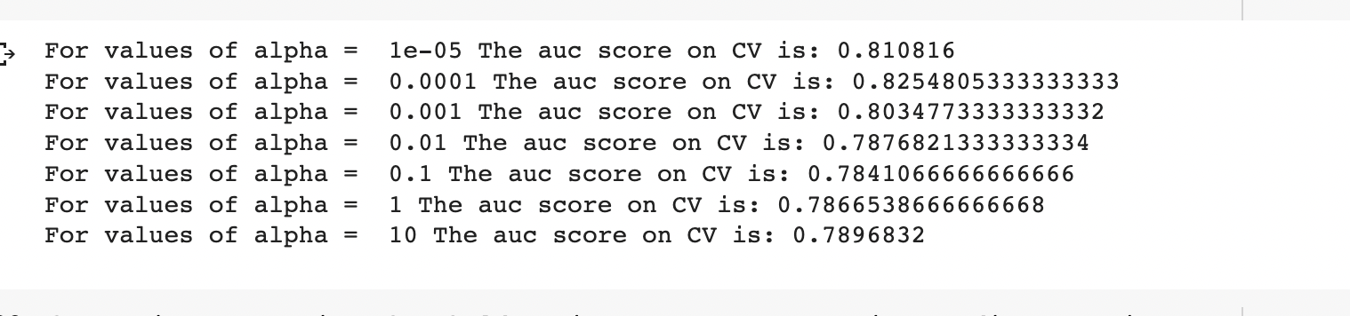
Baseline Model : TFIDF + SGD
Binary Classification Problem where we have to classify a given comment as toxic or Non-toxic.
TFIDF with SGD Classifier for different alphas were tried, Best alpha=0.0001
Penalty L2, log loss
TFID parameters:
Ngram range: (1,2), Min df: 3, smoothing

Slide 8
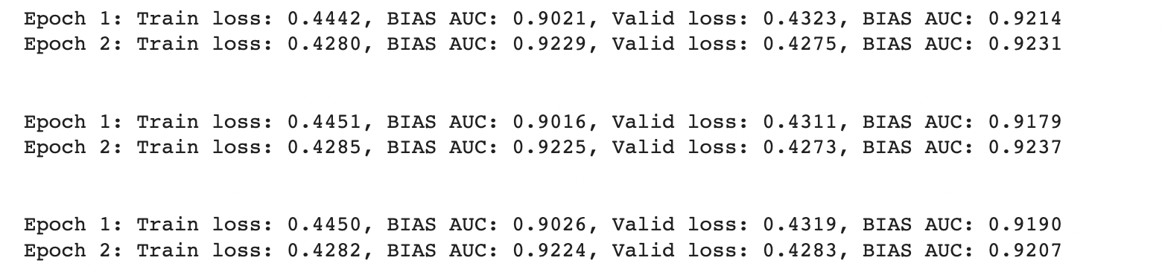
Deep Learning Model: LSTM + GRU
Text Padding to 200 words
KFold=3
Transformed sentence to seq of words
Glove embeddings for Vocab, max =500000
Batch Size=512
Epochs=2
Embedding vocab size: 404791
Log Loss Function
Adam Optimizer
Layers
Bidirectional LSTM
Linear
GRU
GRU +LSTM
Output Linear
Hidden Layer size= 64, 32, layers=2, dropout=0.2

Slide 9
What went well
By carefully pre-processing the data we were able to reduce the bias loss and got test auc of 0.92.
We were able to achieve the goal which means sensitive categories were fairly classified.
Improved weighted loss function as per subgroups.

Slide 10
What didn’t went well
Pre-processing takes so much time even with GPU
Training also takes a lot of time and had to restart notebook when memory was full.
Some libraries had version issues so had to change modeling so many times.
TFIDF Model didn’t do well for classification.

Slide 11
Future scope
Text Augmentation to include other resources
Ensemble of BERT and LSTM Models
Methods like improved Bucket Sequencing to fasten training

Slide 12
THANKS

